Slide 1
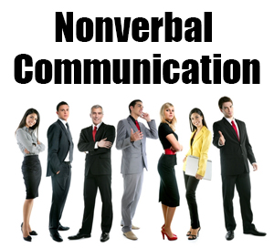

Slide 2
Non Verbal Communication
Nonverbal communication (NVC) between people is communication through sending and receiving wordless clues. It includes the use of visual cues such as body language (kinesics), distance (proxemics) and physical environments/appearance, of voice (paralanguage) and of touch (haptics).[1] It can also include chronemics (the use of time) and oculesics (eye contact and the actions of looking while talking and listening, frequency of glances, patterns of fixation, pupil dilation, and blink rate).

Slide 3
Types of N.V.C.
The types of interpersonal communication that are not expressed verbally (with speech) are called non-verbal communications. There are many different types of non-verbal communication. 1) Body Movements (Kinesics), for example, hand gestures or nodding or shaking the head; 2) Posture, or how you stand or sit, whether your arms are crossed, and so on; 3) Eye Contact, where the amount of eye contact often determines the level of trust and trustworthiness; 4) Para-language, or aspects of the voice apart from speech, such as pitch, tone, and speed of speaking; 5) Closeness or Personal Space (Proxemics), which determines the level of intimacy;Facial Expressions, including smiling, frowning and even blinking; and 6) Physiological Changes, for example, sweating or blinking more when nervous.

Slide 4
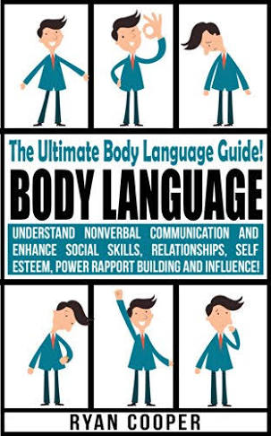

Slide 5
Body Language
Body language must not be confused with sign language, as sign languages are full languages like spoken languages and have their own complex grammar systems, as well as being able to exhibit the fundamental properties that exist in all languages.Body language, on the other hand, does not have a grammar and must be interpreted broadly, instead of having an absolute meaning corresponding with a certain movement, so it is not a language like sign language,and is simply termed as a "language" due to popular culture.

Slide 6
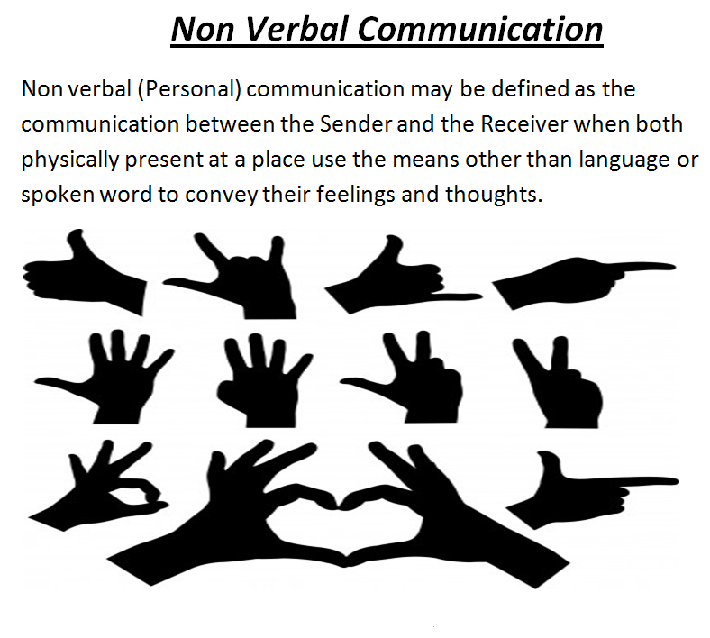

Slide 7
Gestures
There are three main types of gestures: adaptors, emblems, and illustrators (Andersen, 1999). Adaptors are touching behaviors and movements that indicate internal states typically related to arousal or anxiety. Adaptors can be targeted toward the self, objects, or others. In regular social situations, adaptors result from uneasiness, anxiety, or a general sense that we are not in control of our surroundings. Many of us subconsciously click pens, shake our legs, or engage in other adaptors during classes, meetings, or while waiting as a way to do something with our excess energy.

Slide 8
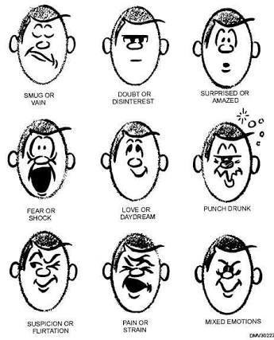
Facial Expressions

Slide 9
Facial Expressions
Our faces are the most expressive part of our bodies. Think of how photos are often intended to capture a particular expression “in a flash” to preserve for later viewing. Even though a photo is a snapshot in time, we can still interpret much meaning from a human face caught in a moment of expression, and basic facial expressions are recognizable by humans all over the world.

Slide 10
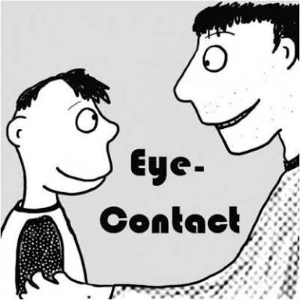

Slide 11
Eye Contact
We also communicate through eye behaviors, primarily eye contact. While eye behaviors are often studied under the category of kinesics, they have their own branch of nonverbal studies called oculesics, which comes from the Latin word oculus, meaning “eye.” The face and eyes are the main point of focus during communication, and along with our ears our eyes take in most of the communicative information around us.

Slide 12
Thank You !

